Slide 1
Consolidated Collection Planning Report
Issues: In the current scenario, where the planning engine runs daily, users receive separate reports for each entity. This requires them to open multiple emails to identify issues and take the necessary actions, which can be time-consuming and inefficient.
Process Implemented: In the newly implemented process, all errors are consolidated into a single email accompanied by an error summary. This streamlines the process, reducing the need to track each step individually, which can be a challenging and time-consuming task, as shown in the diagram below.
Features of the Consolidated Report:
Tracking: Monitors the loading of flat files and the collection job set.
Refresh Count: Displays the number of collection refreshes.
Data Metrics: Includes input count, merged count, and error count.
Dynamic Error Reporting: Provides error report links for each entity, complete with parameters.
Single Excel – One excel being sent out in email for collection stats and error summary report.

Slide 2
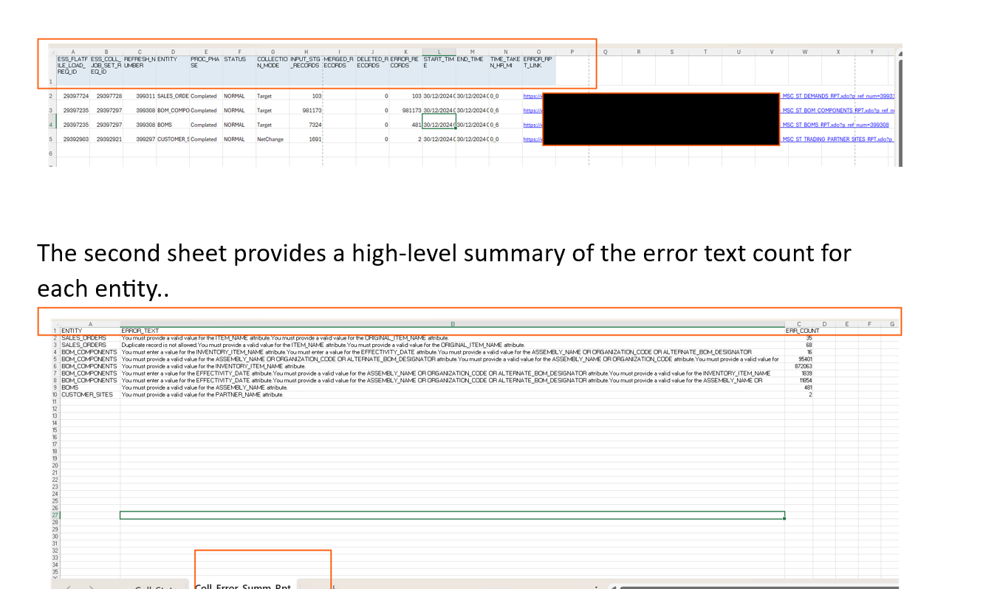
Sample Output:

